Slide 1

Development of a C++ based user-interface for a plasma simulation tool
Name: Zhang,Junming
Student ID: 201138928

Slide 2
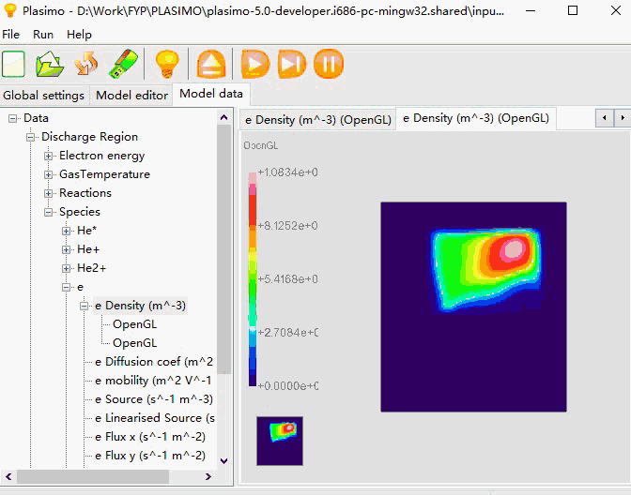

Background theory
Transient and steady-state simulations of plasma sources
POWERFUL!
plasimo-5.0-developer
Notes:
Edit as you see fit

Slide 3
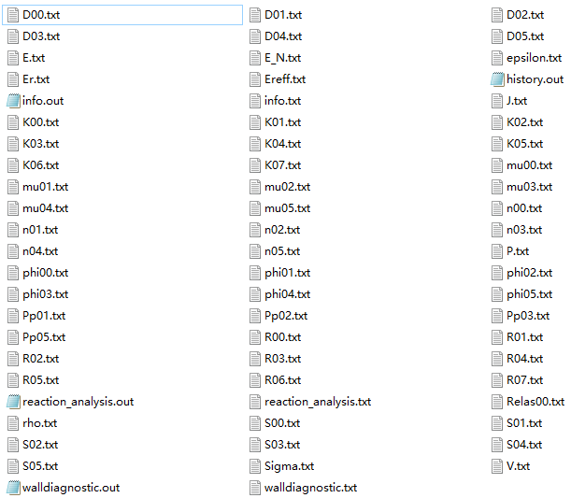
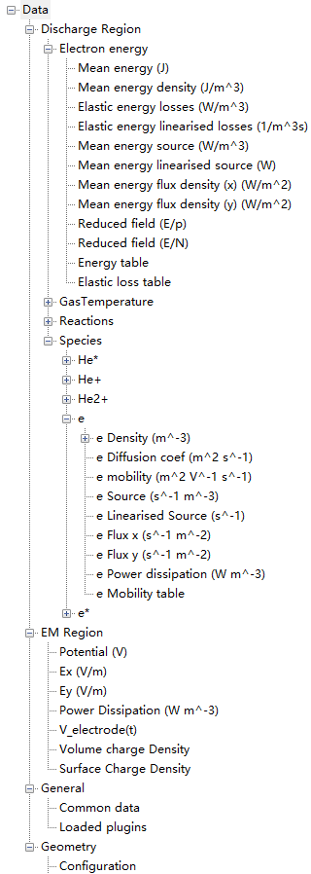
Background theory
68 text files as output data

Slide 4
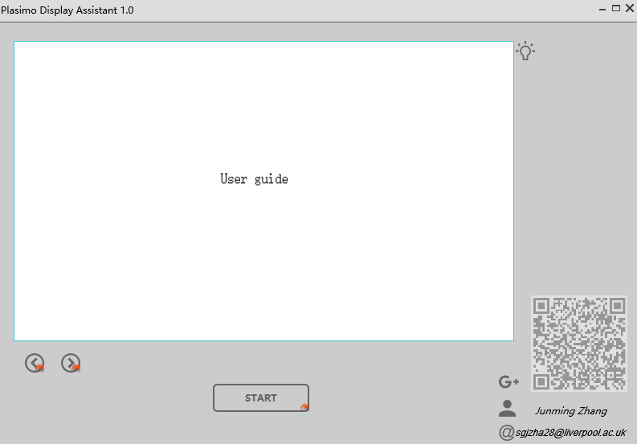
Progress made so far
Open specified guide
Scan to open blog
Read basic operation
Choose output folder

Slide 5
Development of a C++ based user-interface for a plasma simulation tool
Junming Zhang
Electrical Eng & Electronics Bench Inspection
Wednesday March 29th 2017
Supervisor: Dr Mark Bowden
Assessor: Dr Kirsty McKay

